Slide 1

PEI Research Initiative
Finding and re-using research data workshop UCD Health Sciences Library, 15th June 2017
Session 12:00 – 13:00
Ruth Geraghty
Data Curator
Children’s Research Network

Slide 2
This session will cover the following:
Part 1: Background to the PEI Research Initiative – how we got here and lessons learned so far
Part 2: Preparing for Life collection
Part 3: Children’s Profile at School Entry collection
Part 4: Early Childhood Care and Education collection
Part 5: What do you get in a curated PEII collection?
Later on today – PEI Research Grants

Slide 3
Part 1: Background
Foundations of the data archiving project at the Children’s Research Network

Slide 4


Prevention and early intervention (PEI) one of the ‘issues’ tackled by The Atlantic Philanthropies’ investment in Ireland
Prevention = prevent a problem occurring
Early intervention = intervene before problem gets worse
2004 – 2014 extended period of investment
Sometimes in conjunction with government and other organisations

Slide 5

Ten Years of Learning, Rochford et al., 2014
€127 million investment by Atlantic Philanthropies over 10yrs
30 partner agencies and community groups
52 prevention and early intervention services and programmes across RoI and NI
Services operating across a diverse range of areas in child and youth well-being:
  Early childhood
  Learning
  Child behaviour and development
  Parenting
  Inclusion
“A condition of funding for the PEII projects was that the organsiations involved were required to rigorously evaluate the effectiveness of their services in improving outcomes for children” (pg. 4)
http://www.effectiveservices.org/resources/article/prevention-and-early-intervention-in-children-and-young-peoples-services-te
http://www.effectiveservices.org/downloads/PEII_10_Years_of_Learning_Report.pdf

Slide 6



Why make evaluation a condition of funding?
EVIDENCE
“Evidence can be a powerful engine for advancing change when practitioners are given robust tools or support to apply it in their work”
  (from AP website)
SUSTAINABILITY
“Building partnerships with government, NGOs and communities from the start can lead to better and more sustainable outcomes”
  (from AP website)
A LARGE BODY OF DATA OF INTERNATIONAL SIGNIFICANCE AND RANGE
But where is the data and how do we make it accessible?

Slide 7



















Slide 8

Picking the right tool for the job:
(below a small sample of actual evaluation designs used by PEII projects)
Randomised control trial, plus qualitative interviews with staff, plus a cost analysis
Retrospective survey of administrative data that was collected a few years ago and repurposed
Two-group pre-post test design using a survey of parents and teachers
Quasi-experimental mixed methods design
Longitudinal randomised control trial using a comparison community, focus groups with parents at key stages in the study, qualitative interviews with staff, and a cost analysis
Exploratory qualitative research
The result is a mixed bag of research data types
Population demographics
Scale and indices scores
Qualitative transcripts
Behavioural indicators

Slide 9



The drive to archive
VALUE FOR MONEY
DISSEMINATION
COMPARABILITY
AP investment unprecedented
Data can go further than a report (which can age very quickly)
International relevance – data starts to be used comparatively
All involved (organisations, evaluators) agreed – when approached by CRN in 2016 - that in principle archiving this data would be a very good thing.

Slide 10
Evaluation data is an extreme example of the sensitivities and tensions in social research data
Outcome evaluation
How the programme performed
Process evaluation
How the programme worked in practice
What makes it sensitive:
Control group v’s trial group
Standardised measures, for example child’s cognitive and emotional development or a parent’s sense of confidence
Demographic info used to explore causal factors
Baseline – most risky in term of identification of individuals
Longitudinal element = characteristics gathered repeatedly
What makes it sensitive:
Opinions of participants, or feedback from staff - could be quite critical
Honest feedback is essential
Personal stories – these tend to be vulnerable populations

Slide 11
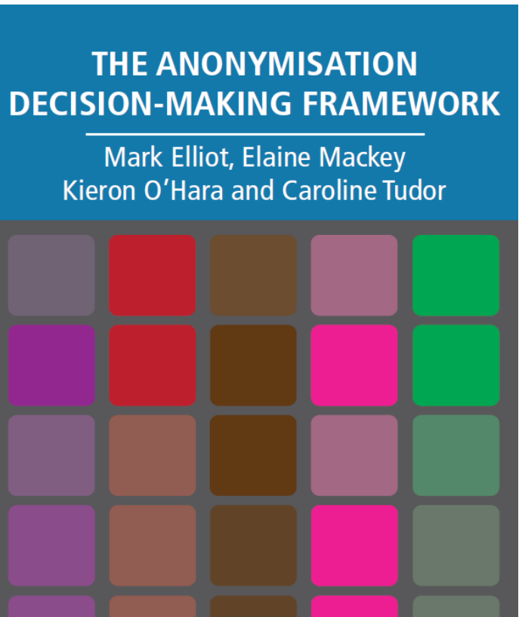
Safe and ethical archiving
Three steps to sharing sensitive data (as proposed by most social science archives)
Gain consent to share
Anonymise the data
Control access
http://ukanon.net/ukan-resources/ukan-decision-making-framework/

Slide 12
Why do you have to ‘process’ research data?
Example of impact analysis data
1. Locate the correct version of the file
4. Anonymise the data
6. Collate contextual material
3. Clean data & standardise missing data codes
5. Check copyright on scale measures
2. Check and add meaningful labels
7. Create metadata and publish data in the right archive

Slide 13
Part 2: Preparing for Life collection
Northside Partnership and UCD Geary Institute

Slide 14
The PFL programme
Operated by Northside Partnership in Dublin
Objective: improve levels of school readiness of young children from several disadvantaged areas in North Dublin
Intervention: pregnancy to age 4 (school entry)
Bottom up development
Home visiting programme: PFL families receive a range of supports including:
  Assigned a mentor who visits home regularly
  Tip sheets – easy to read info on child development
  Parent training course (Triple P Parenting Programme)
Notes:
Operated by the Northside Partnership in Dublin
Objective: improve levels of school readiness of young children from several disadvantaged areas in North Dublin
Intervening during pregnancy and working with families until the children start school
Developed by 28 local agencies and community groups (bottom up) over 5 years and tailored to meet the needs of the local community and was grounded in empirical evidence
home visiting programme
assisting parents in developing skills to help prepare their children for school
PFL families receive a range of supports
Families in the high treatment group were assigned mentor who visited their home fortnightly or monthly, for between 30 minutes and two hours from pregnancy (about 21 weeks)
parents make informed decisions
Tip Sheets, which were colourful representations of information related to child development presented in a clear, concise manner and were developed by PFL staff based on available information from local organisations such as the Health Service Executive, the Department of Health and Department of Children and Youth Affairs, and Barnardos Children’s Charity
Triple P aims to improve positive parenting through the use of videos, vignettes, role play, and tip sheets in a group-based setting for eight consecutive weeks

Slide 15
The PFL evaluation
UCD Geary Institute (Dr. Orla Doyle)
2008 – 2015
7 waves of data collection:
  prenatal baseline, 6 months, 12 months, 18 months, 24 months, 36 months, 48 months
Mixed methods approach
  Impact evaluation, implementation analysis, process evaluation, direct observation of children using British Ability Scale at school entry
Randomisation into low support and high support, plus a comparison community
Notes:
The PFL programme was evaluated between 2008 and 2015 by the UCD Geary Institute at University College Dublin, Ireland to provide evidence on the effectiveness of the PFL programme to positively impact on parent and child outcomes

Slide 16
The archived PFL data
Approx. 300 cases – repeat data collection over 7 points
Series of standardised measures and indices used – some at every point and some at key points
Other data:
At four years of age direct observation using BAS
Connection to the CPSE – school readiness assessed by child’s teacher and by primary caregiver using the Early Development Instrument (S-EDI)
Qualitative data will be prepared next for IQDA
  Focus groups with primary caregivers
  Focus groups and interviews with fathers
  Interviews with PFL staff (e.g. mentors)

Slide 17
PFL: something for every researcher
Impact evaluation data
7 waves of measures and scales from CAPI survey with primary carer
High, low and non-support measured
Long list of standardised scales used
Archived in ISSDA
BAS at school entry
Direct assessment of 4yr olds by researchers using BAS
High versus low treatment groups
Archived in ISSDA
Profile at school entry
General sample of children from the local area at school entry
Comapred with
High and low treatment PFL children at school entry
2008 – 2015 (8 years)
Archived in ISSDA
Process evaluation data: parents
Qualitative interviews with programme staff
Focus groups with mothers
Focus groups with fathers
Will be archived in IQDA
Qualitative interviews with children at 4yrs of age
Children’s drawings and follow up qualitative interview
Will be archived in IQDA

Slide 18
What’s inside PFL: Domains
EIGHT DOMAINS
Child development
Child health
Parenting
Home environment
Maternal health and wellbeing
Social support
Childcare and service use
Household factors and socioeconomic status

Slide 19
What’s inside PFL: A small sample of the standardised instruments used
Ages & Stages Questionnaire (ASQ)
Developmental Profile-3 (DP 3)
Achenbach Child Behaviour Checklist (CBCL)
Strengths and Difficulties Questionnaire (SDQ)
Children’s Sleep Habits Questionnaire (CSHQ)
Parenting Daily Hassles Scale (PDH)
Parenting Stress Index (PSI)
Parenting Styles and Dimensions Questionnaire (PSDQ)
Home Learning Environment (HLE)
Framingham Safety Survey (FSS)
Rosenberg Self-esteem Scale (RSE)
Edinburgh Postnatal Depression (EPD)Scale
In the archived dataset scale acronym in caps is used to distinguish the standardised measures – to allow cross-dataset tracking

Slide 20
What’s inside PFL: Some other topics examined – a small sample
Prenatal intention to breastfeed followed by breastfeeding practice
Maternal nutrition and child nutrition
Social support – partner to neighbours
Participation, voting
Substance use and changes during pregnancy
Children’s screen time
Children’s sleeping habits….
  …to name a few

Slide 21
Part 3: Children’s Profile at School Entry collection
Northside Partnership and UCD Geary Institute

Slide 22
Purpose of CPSE study – connection to PFL
Conducted by PFL evaluation team from 2008 – 2015
Annual survey of levels of school readiness of Junior Infant children at entry to Primary School
Provided a comparison from the general population in PFL catchment area against which PFL children could be compared
8 waves of data collection (Oct-Dec every year)
PFL children included in the sample from Wave 5 (sample reached school age from 2012 onwards) – PFL cases are listed in the data
Notes:
The Children’s Profile at School Entry (CPSE) study was conducted between 2008 and 2015 as part of the wider Preparing for Life intervention by the Northside Partnership and its evaluation by the UCD Geary Institute at University College Dublin
The CPSE study took place in parallel to the PFL evaluation, and provided an annual, representative survey of the levels of school readiness of all Junior Infant children in the PFL catchment area – both those participating in PFL and the general population not participating in PFL. The annual survey 1) indicated the general level of school readiness of children attending schools in the PFL catchment area, 2) indicated whether the PFL programme was generating positive Junior Infants is the entry level class for primary education in the Republic of Ireland. Children commence Junior Infants at approximately 4 to 5 years of age.

Slide 23
The CPSE study design
Teacher survey
  Demographic questions about self
  School readiness using SEDI measure
  School readiness using PFL (and subjective) measures
Parent survey
  Socio-demographic info about self/household
  Mental health of primary carer
  Parenting
  School readiness using SEDI measure
  School readiness using PFL (and subjective) measures

Slide 24
The archived CPSE data
8 waves (years) of data
Approx. 980 cases – data collected once per case but from two sources
Set of standardised measures and indices used
Connection to the PFL data – the child’s PFL ID is included to allow for cross-dataset analysis

Slide 25
What’s inside CPSE
DOMAINS
Household factors and socioeconomic status
Indications of school readiness
Parenting
Caregiver (maternal) health and wellbeing
Teacher demographics
MEASURES
Early Development Instrument about child (S-EDI)
Mental well-being assessed using WHO-5
Center for Epidemiologic Studies Depression Scale (CES-D)
Parenting Styles and Dimensions Questionnaire (PSDQ)

Slide 26
Part 4: Early Childhood Care and Education collection
Tallaght West Childhood Development Initiative
Centre for Social and Educational Research, Dublin Institute of Technology
and Institute of Education, University of London

Slide 27
The Early Years programme
2-year programme targeted at children and their families in Tallaght West
Targeted all families in Tallaght West but especially children that face barriers to educational achievement and well-being
The CDI Early Years Programme explicitly sought to improve children’s ability to learn and to make them more ready for school, both socially and cognitively (school readiness)
Intervention delivered via the early years service: low-cost childcare with HighScope principles, minimum staff qualifications, longer working week, lower child to staff ratio, access to services…

Slide 28
The Early Years evaluation
A cluster randomised trial: Early Years services were randomly allocated to the intervention or the control
Two cohorts x three data collection points
  Cohort 1
    Baseline: Autumn 2008
    Mid-phase (end of first year): Summer 2009
    End phase (end of second year): Summer 2010
  Cohort 2
    Baseline Autumn 2009
    Mid-phase (end of first year): Summer 2010
    End phase (end of second year): Summer 2011

Slide 29
The Early Years evaluation
Child level assessment
Parent level assessment
Care setting level assessment
Collected at Baseline, Mid-Phase and End phase
Standardised child assessments taken over time measuring cognitive, verbal, spatial development, and emotional and pro-social development
Instrument: direct assessment of children by researcher (similar method to PFL BAS data)
Suite of standardised scales
Collected at Baseline and End phase
Child social/behavioural profiles and assessment of child’s development. Other measures of parenting and home learning environment collected.
Instrument: survey with primary caregiver (similar method to PFL)
Mix of household demographics and standardised scales
Collected once during study
Quality assessments of the Early Years services of the care setting environment using ECCRS-R and ECCERS-E and CIS
Assessment conducted by specially trained researchers
Used a specific scale that had been designed by one of the co-investigators

Slide 30
What’s inside ECCE - overview
Parent level measures
Strengths and Difficulties Questionnaire (SDQ) – measured child
Parent Stress Scale
Home Learning Environment Index
Service level measures
Early Childhood Environmental Rating Scale (ECERS-R)
Early Childhood Environmental Rating Scale - Extension (ECERS-E)
Arnett Caregiver Interaction Scale (CIS)
Child level measures
British Ability Scales 2nd Edition [BAS II]
Rhyme and Alliteration
Lower letter recognition
Adaptive Social Behaviour Inventory [ASBI]
Strengths and Difficulties Questionnaire [SDQ]

Slide 31
Part 5: What do you get in a curated PEII collection?
Curated by the Children’s Research Network in 2016 - 2017

Slide 32
Description of data file
Delivered in .sav but should be useable across range of formats
Variables are named and labelled to match survey as closely as possible – for ease of reference
Anonymised and derived variables content clearly labelled and info given in codebook
Missing data in categorical variables marked with standardised value codes (996, 997 etc)
All cases included in multi-wave studies to allow merging (so missing cases included)
Notes:
Data files
cleaned, labelled in full
Anonymised
Derived variables labelled as such
Missing data marked in file
Checked to ensure waves can be merged
Data files are usually restricted to approved users – access given under certain conditions
Codebooks
Notes contain supplementary information
Some basic frequencies
This is openly available material

Slide 33
Description of codebook
Variables are listed chronologically as they appear in the archived data file. For each variable the following information is provided:
  Variable name
  Position
  Label
  Type
  Code values are listed for nominal variables
  Missing values including “don't know”, “not applicable” and “refuse”
  Some basic frequencies
Each codebook concludes with a chronological index of variables in the appendix. The name and label for each variable is provided in this index. Also variables are categorised into the eight major domains of the study for quick reference, and in some cases additional information is provided to assist the user to find groups of variables of particular interest.

Slide 34
Description of survey
Copy of the survey that was used to collect the data is provided in PDF
Scale materials that cannot be shared due to copyrighted restrictions are redacted but cited
Users should refer to survey to examine full text of original question (not always possible to fit it into label)

Slide 35
Ruth Geraghty, Data Curator and Researcher
Questions?
rgeraghty.crn@effectiveservices.org

